Slide 1
The Strengths and Difficulties of the SDQ
Reviewing and Analyzing the Use of the SDQ at Alternatives

Slide 2
What is the SDQ?
The Strengths and Difficulties Questionnaire (SDQ) is a brief behavioural screening questionnaire for 3-16 year olds. It exists in several versions to meet the needs of researchers, clinicians and academics. It is available as a self-report (SDQ-S), parent/caregiver (SDQ-P) and teacher report version (SDQ-T).
A combined scale score of four categories reflects total difficulties, indicating the severity and the content of the psychosocial problems. The prosocial scale indicates the amount of prosocial characteristics a child shows.
The SDQ is translated into over 60 languages and used in many countries.

Slide 3
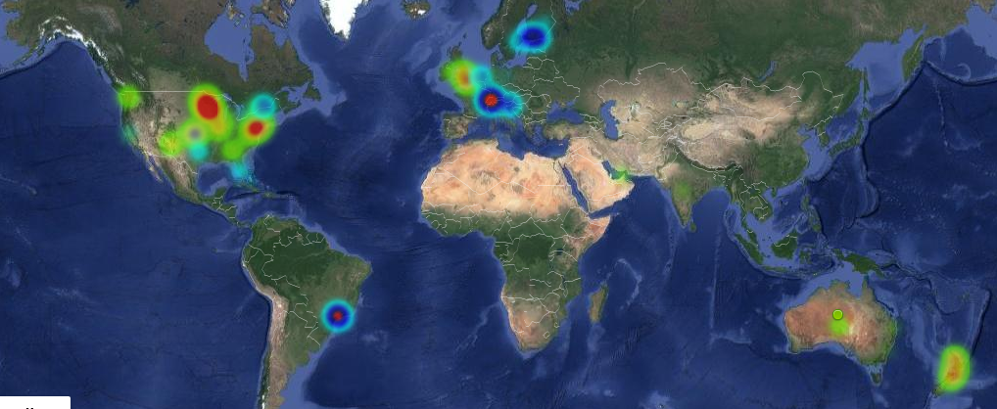
Internet use of SDQ scoring website on Wednesday, 18 December 2019:

Slide 4
SDQ CONTENT
All versions of the SDQ ask about 25 attributes, some positive and others negative. These 25 items are divided between 5 scales:
1. emotional symptoms (5 items)
2. conduct problems (5 items)
3. hyperactivity/inattention (5 items)
4. peer relationship problems (5 items)
5. prosocial behaviour (5 items)
1-4 added together to generate a total difficulties score (based on 20 items)
An impact supplement
This extended versions of the SDQ ask whether the respondent thinks the young person has a problem, and if so, enquire further about chronicity, distress, social impairment, and burden to others.
Follow-up questions
The follow-up versions of the SDQ include not only the 25 basic items and the impact question, but also two additional follow-up questions for use after an intervention. Has the intervention reduced problems? Has the intervention helped in other ways, e.g. making the problems more bearable?
Examples: “I am often unhappy, depressed or tearful” or “I am kind to younger children” not true/somewhat true/certainly true

Slide 5

Who Invented the SDQ?
The Strengths and Difficulties Questionnaire (SDQ) was developed by United Kingdom child psychiatrist Robert N. Goodman in 1997.

Slide 6
Why is this tool built and used? What is its purpose?
Robert Goodman, inventor of the SDQ, estimated that there are a significant number of children and young people (5% or more) with serious, but unrecognized mental health disorders. Since its development, the Strengths and Difficulties Questionnaire (SDQ) has been widely used in both research and practice to identify unrecognized mental health disorders and symptoms in children.
The Child Behavior Check List has long been viewed as the “gold standard” in assessing childhood problems. During the 90s attention for early and quick detection of childhood psychopathology increased. Whereas the CBCL is a very solid instrument in doing in-depth assessment, the SDQ may be more suitable for screening purposes.
The SDQ is not intended to be used as a psychiatric diagnostic instrument.

Slide 7
How the sdq is scored
To score the SDQ go to:https://sdqscore.org/
The initial bandings presented for the SDQ scores were ‘normal’, ‘borderline’ and ‘abnormal’. These bandings were defined based on a population-based UK survey.
More recently a four-fold classification has been created based on an even larger UK community sample. This four-fold classification differs from the original in that it:
(1) divided the top ‘abnormal’ category into two groups, each containing around 5% of the population
(2) renamed the four categories
80% ‘close to average’,
10% ‘slightly raised,
5% ‘high’
and 5% ‘very high’ for all scales
except prosocial, which is 80% ‘close to average’, 10% ‘slightly lowered’, 5% ‘low’ and 5% ‘very low’

Slide 8
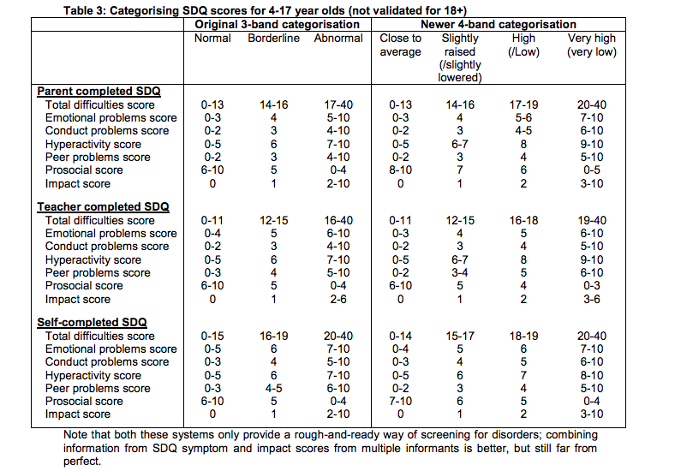
Example of scoring the sdq:

Slide 9
Clinical uses of sdq
Clinical Assessment:
Many child and adolescent mental health clinics now use the SDQ as part of the initial assessment, getting parents, teachers and young people over the age of 11 to complete questionnaires prior to the first clinical assessment. The findings can then influence how the assessment is carried out and which professionals are involved in that assessment.
For example, if a child has been referred with marked conduct problems, an assessment that focused too narrowly on these behaviours and related family issues might overlook associated hyperactivity. Advance knowledge that the child has been given high SDQ hyperactivity ratings by parents and teachers can help ensure that the assessment inquires in detail about hyperactivity.
Evaluating Outcomes:
"Before" and "after" SDQs can be used to audit everyday practice (e.g. in clinics or special schools) and to evaluate specific interventions (e.g. parenting groups). Studies using the SDQ along with research interviews and clinical ratings have shown that the SDQ is sensitive to treatment effects. Child and adolescent mental health services, and other specialist services for children with emotional and behavioural difficulties, can use an 'added value' score based on the SDQ as one index of how much help they are providing to the young people they see.

Slide 10
Clinical uses continued
Epidemiology:
The SDQ is well adapted for studies of the general population since it is a dimensional measure across its full range, with each one-point increase corresponding to an increased rate of disorder. In addition, the same risk factors that predict change in total difficulty score across the entire range also predict it in children one standard deviation above and one standard deviation below the mean. In Britain, mean SDQ scores can be used to generate prevalence estimates in subpopulations defined by a wide range of characteristics (e.g. ethnicity, family type, socio-economic deprivation). Note, however, that these prevalence estimators cannot be used to generate valid prevalence estimators cross-nationally.
Research:
The SDQ is being used as a research tool throughout the world - in developmental, genetic, social, clinical and educational studies.
Screening:
In community samples, multi-informant SDQs can predict the presence of a psychiatric disorder with good specificity and moderate sensitivity.

Slide 11

How sdq is relevant to alternatives?
Alternatives uses the SDQ for:
1. Screening and clinical assessment
2. Outcomes
Outcomes are provided to funders:
Private funders may require SDQ outcomes.
Distribution of their funding is based on improvement of client.
Funders ask various specific questions (about emotional growth, or about hyperactivity). Alternatives responds by providing them data from:
Impact survey
Discharge survey
SDQ

Slide 12
Funding overview
Diversity of funding sources: we have all sorts of funders such as long-term funders and short-term, private and public, state and federal funding.
These funders are always changing, coming and going, not static. All of them want different data (use different questions from SDQ).

Slide 13
Where we are now at alternatives with SDQ use
Does Alternatives score the SDQ data at all? YES.
Clinicians administer SDQ when they open and close the file.
Supervisors enter the SDQ into ETO.
BHS Coordinator or Supervisor does basic data quality control.
Data Coordinator pulls the report.
Example of scoring Alternatives data: “Emotional problems improved from pre to post.”
Funders ask about: showing improvement? Stay the same? Regress?
Alternatives cannot count the SDQ if it does not have a post survey.
With no post survey, SDQ does not lead to outcomes.
Alternatives therapists are currently not instructed on any specific way to use SDQ data to guide their practice as a screening and assessment tool.

Slide 14
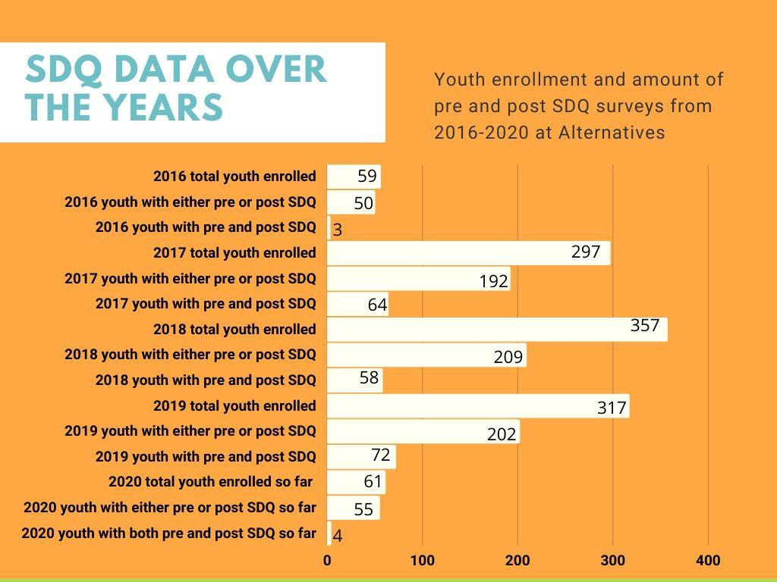

Slide 15
2016: youth with pre and post SDQ made up 5.08% of total youth that year
2017: youth with pre and post SDQ made up 21.55% of total youth that year
2018: youth with pre and post SDQ made up 16.25% of total youth that year
2019: youth with pre and post SDQ made up 22.71% of total youth that year
So far in 2020: youth with pre and post SDQ made up 6.56% of total youth that year

Slide 16
Areas for growth
1. Low number of post SDQs filled out by BH staff, thus rendering all those pre SDQs useless. Reason this occurs often is: client no show.
2. Unclear what the purpose or relevance of the SDQ is to BH staff’s clinical practice (how can it be useful to therapy? How do therapists use it to screen and assess clients?).
Pitfalls in process of entering data:
Collecting
How to collect this data remotely? Best practices/uniform way all therapists do this?
Entering data in ETO
Is it easy to find/enter in ETO?
Initial to follow up
Does supervisor remind you to enter it when you close a case/check this before signing off?
Are you remembering to do a mid SDQ?
Outcomes
Are the outcomes communicated to BH staff in a clear way? Do staff understand them? Monthly? Quarterly? Yearly?
Is BH staff using the outcomes to guide their practice/improve?

Slide 17
Brief pause to type in the chat
Other pitfalls or areas of growth you see
Thoughts and feedback on what was listed

Slide 18
Recommendations
Create general clinical guidance for all therapists on how to use SDQ to guide their practice, thus creating consistency and clarity on how SDQ is relevant to therapists and their practice beyond being mandatory for grants.
Create video instructions for how to open a case, close a case, ect, so doing all the various administrative tasks required is easier for therapists. Therapists will then be more likely to complete the post SDQ. Guidance on how to use the SDQ results to guide clinical practice decisions can be included in this video (or be another one). Have written instructions in addition to video for different learners (people’s brains work differently!).
Clearly and consistently communicate both in training video and regularly during team meetings and individual supervision that the SDQ is vital for funding and for the agency, and therapists need to complete a pre and post SDQ to assure compliance to grants. Have clear consequences for therapists who consistently do not fill out the post SDQs that are written into performance evaluations.

Slide 19
Recommendations continued
Create a standard policy for how therapists administer the SDQ when working remotely.
Create check boxes in ETO where therapists can clarify if they did not administer post SDQ due to fact client was a no show. Take an observation touchpoint that client was no show and write the details, so there is a clearer picture of how many post SDQs were unable to be administered due to a no show and no fault of therapist. Create guidance around how to avoid no shows (rapport building, texting client, explaining what the SDQ is and why you need it from them, what strategies work?).
Encourage therapists to take a “mid-point” SDQ with client, create guidance around when this should be administered (after 4 months? After client shows improvement? If the client is missing more and more sessions and therapist predicts they will completely no show soon?)

Slide 20
Brief pause to type in the chat
Other recommendations you can think of
Thoughts and feedback on what was listed

